Slide 1
RegEx in JavaScript

Slide 2
The Class of Characters
You have 26 alphabets:
# a, b, c, d, e, f, g, h, i, j, k, l, m, n, o, p, q, r, s, t, u, v, w, x, y, z
RegEx provides a way to capture a character from the above class of alphabets.
Let’s do it through code...

Slide 3
Checking if a given character is alphabetical or not
let c = '5'; // Simple variable declaration. Variable of type: “string”
let alphabets = ['a', 'b', 'c', 'd', 'e', 'f', 'g', 'h', 'i', 'j', 'k', 'l', 'm', 'n', 'o', 'p', 'q', 'r', 's', 't', 'u', 'v', 'w', 'x', 'y', 'z']
// Another simple variable declaration. Variable of type: Array
let msg = 'C IS NOT AN ALPHABET'
// ‘msg’ is of type: String
for (let i = 0; i < alphabets.length; i++) {
if (c == alphabets[i]){
msg = "C IS AN ALPHABET"
}
}
// To iterate over ‘alphabets’ we need a variable called ‘i’.
// i starts taking values from 0 till alphabets.length (which is 26)
// Next in the if-condition ( c == alphabets[i] ): it is comparing each alphabet with the contents of variable ‘c’
console.log(msg)

Slide 4
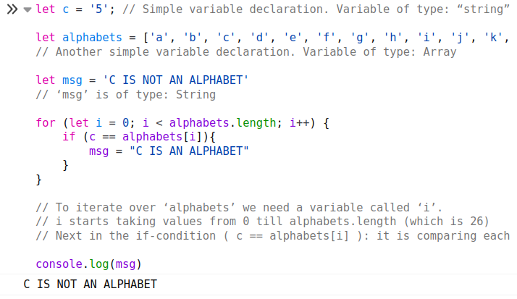

Slide 5
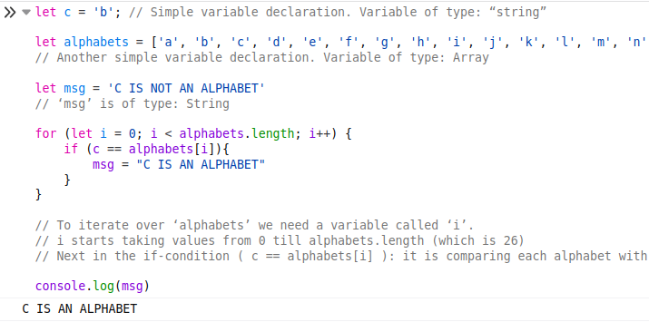

Slide 6
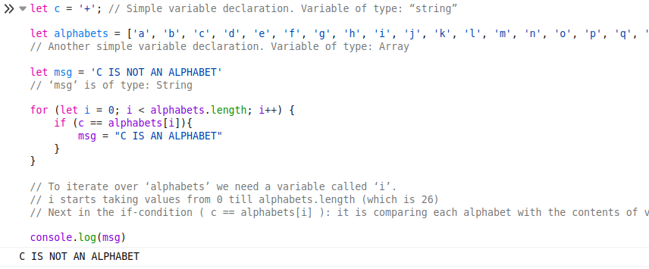

Slide 7
Two Approaches to Solve This Problem
Approach 1:
We have seen that we can compare contents of variable ‘c’ with all the alphabets to see if we get a match.
This is an iterative solution.
Approach 2:
We search for alphabets in the contents of ‘c’.
This would leverage RegEx.

Slide 8
How can we capture an alphabetical character using RegEx?
let d = '5'
d.search('a')
-1
d.search('5')
0
d.search(/[a-z]/)
-1
d = 'f'
"f"
d.search(/[a-z]/)
0
d = '5'
"5"
d.search(/[0-9]/)
0

Slide 9
Problem 1
With regular expressions, you don’t need to know what exactly you want to find.
What you should know is a rough idea about what that you are trying to find looks like.
Q: I want to find if a digit is present in a string.
A:
[] Represents a class of characters.
[0-9] Represents a class of the 10 digits.
You can find a digit by iterating over range(0, 10) and find it a digit is present in a string.
Or, you can tell the computer that if you find any digit from 0 to 9, then let me know.
Which is better?
The solution using range() looks simple but it is elegant enough.
The more Pythonic solution is when we would tell the computer that give me the character that matches the class of digits, i.e., [0-9].

